Slide 1





Become a DISEASE DETECTIVE SOLVE AN OUTBREAK!
@RLadiesMelb

Slide 2
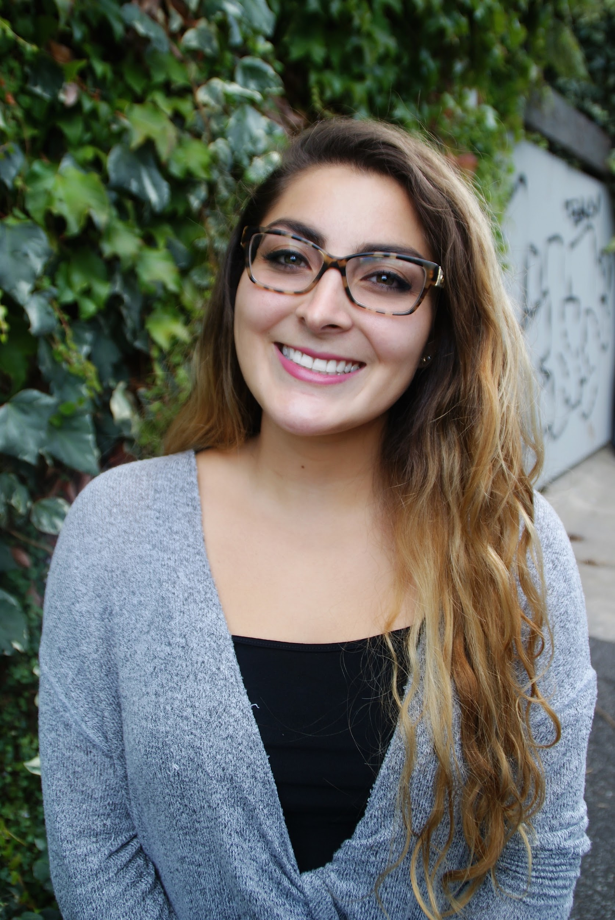
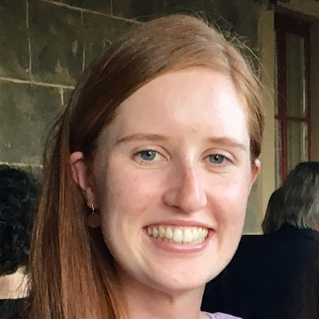
Hello!
We are Shazia Ruybal and Caitlin Bourke
We are here because we want to teach you how to program in R!

Slide 3

What’s R?
Notes:
who knows excel
who knows programming language
… R?

Slide 4
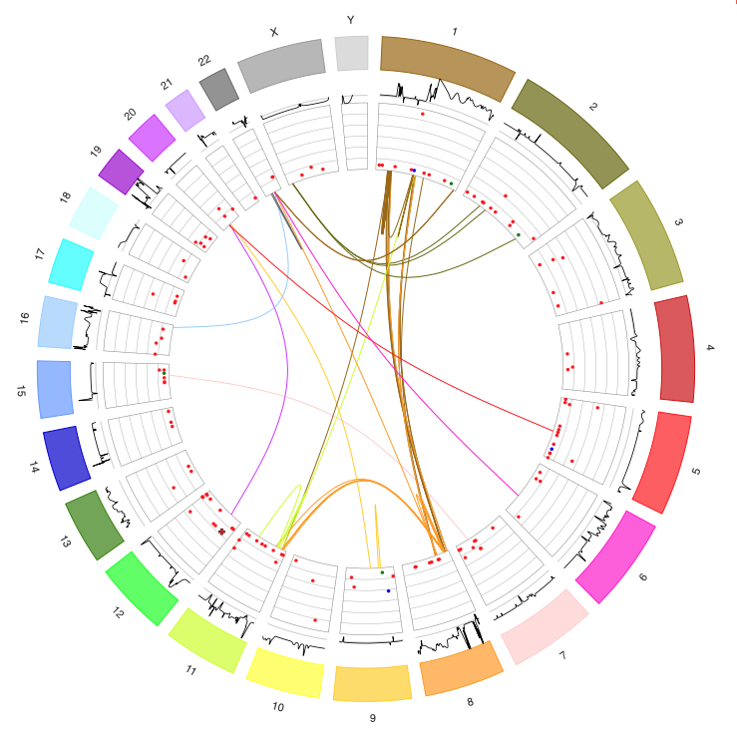
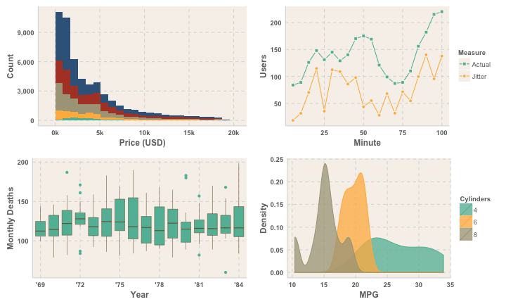
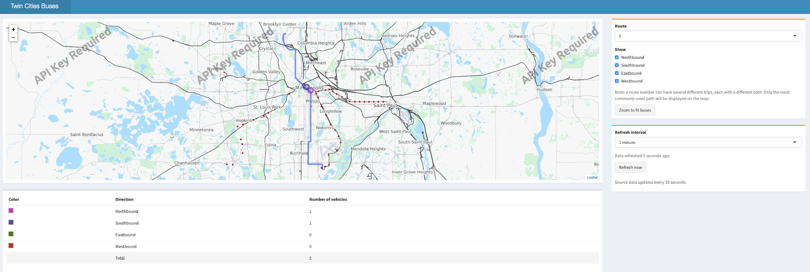
What’s R?
R is a programming language and free software environment for statistical computing and graphics
Notes:
useful for large datasets

Slide 5

Why learn R?
R is free and open source
Learning R is fun and easy
Lots of Libraries
Want the coolest job?
Who uses R ?
Academics and Industry
Notes:
also mention python

Slide 6
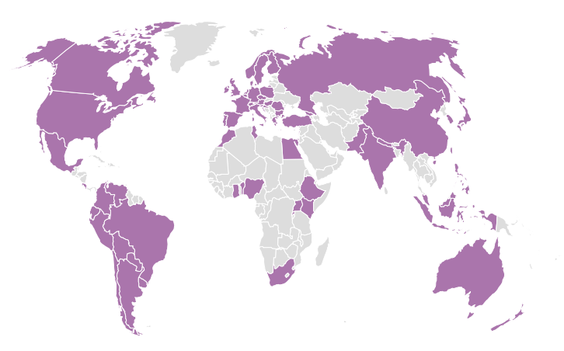

What’s R-LADIES?
MISSION:
It’s a world-wide organization whose mission is to promote gender diversity in the R community
Notes:
mention there is a low number of female in programming field other groups like pyladies

Slide 7

R-Ladies Melbourne was launched on the 18th October 2016

Slide 8





You can find us...
On Twitter, Facebook and Meetup to be updated and register for new events!
https://www.meetup.com/R-Ladies-Melbourne/

Slide 9

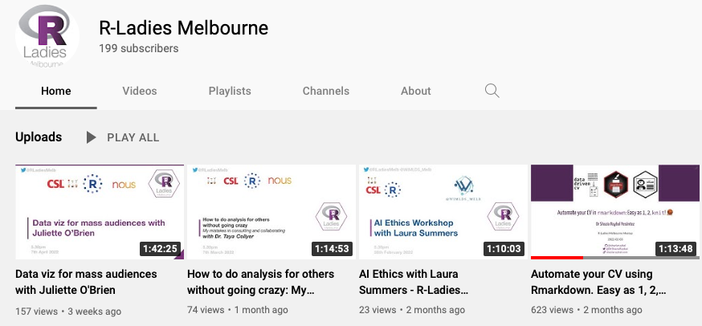
You can find us...
also on YouTube
to see the recording of our events!

Slide 10
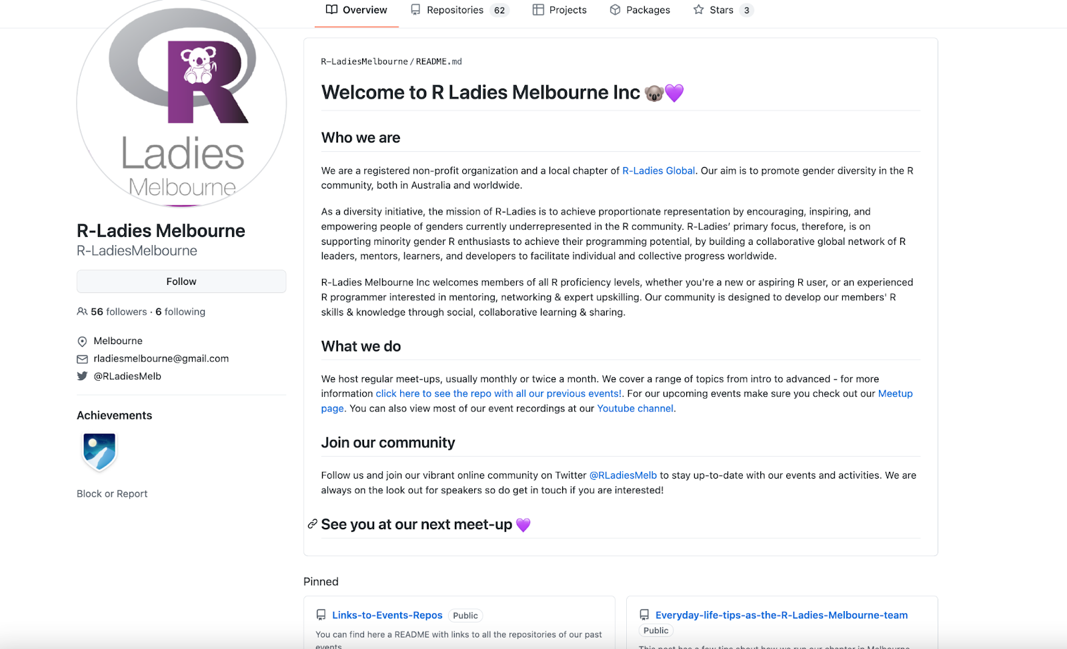

https://github.com/R-LadiesMelbourne
You can find us...
On GitHub to find all the materials and speakers of past events!
https://github.com/R-LadiesMelbourne

Slide 11
TODAY’S WORKSHOP:
What are outbreaks and who are disease detectives?
Learn how to code using R
Disease detective activity
An outbreak has occurred at your school
Use your R skills to become a disease detective and see if you can pinpoint the cause of the outbreak

Slide 12
What is a disease OUTBREAK?
Notes:
Ask the audience…. Can you give me an example?

Slide 13

What is a disease OUTBREAK?
A disease outbreak is the occurrence of cases of disease in excess of what would normally be expected in a defined community, geographical area or season.
An outbreak may occur in a restricted geographical area, or may extend over several countries. It may last for a few days or weeks, or for several years.

Slide 14


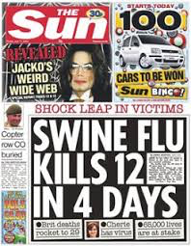
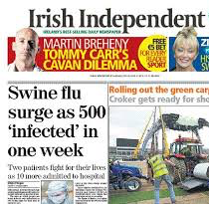
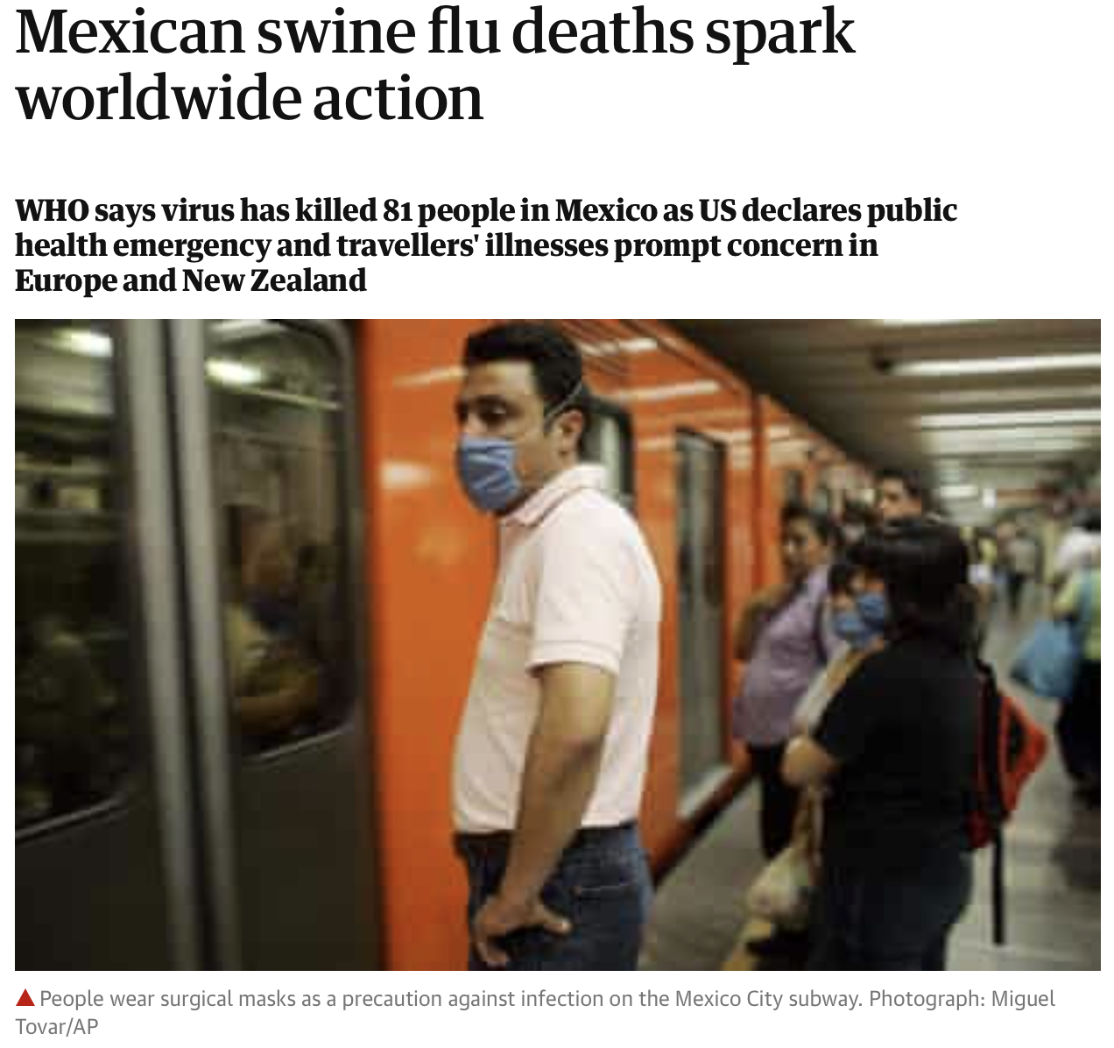
2009: SWINE FLU
Notes:
Every year we get our flu vaccine and there are a number of deaths due to flu but usually in elderly people who are have weaker immune systems. This is what is normally expected. But in April 2009, a new human influenza virus was discovered in Mexico in April 2009 and was identified using genetics as H1N1 flu virus strain or commonly known as swine flu. Swine flu rapidly spread throughout Mexico and across borders. The first case of H1N1 was confirmed in Australia on 9 May 2009. Six months later in December 2009 there were over 37,000 confirmed cases of H1N1 in Australia and 191 people had died as a result of contracting H1N1. Most deaths were in middle-aged adults (not elderly).

Slide 15

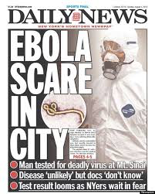
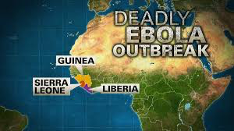
2014: EBOLA
Notes:
More recently, some of you may have heard of or remember the ebola outbreak in 2014 that started in West Africa. Ebola cases had not been reported since the 1970s but in 2014 there was a sudden spike in cases and thousands of deaths. Most of the deaths involved nurses and doctors treating Ebola victims and family members who came into contact with the infected family member. Due to frequent human travel and because it took about three weeks for symptoms to appear, Ebola quickly spread to Europe and the US causing red alert in many countries.
In July of this year an Ebola outbreak in Democratic Republic of Congo is West Africa was declared a public health emergency.

Slide 16

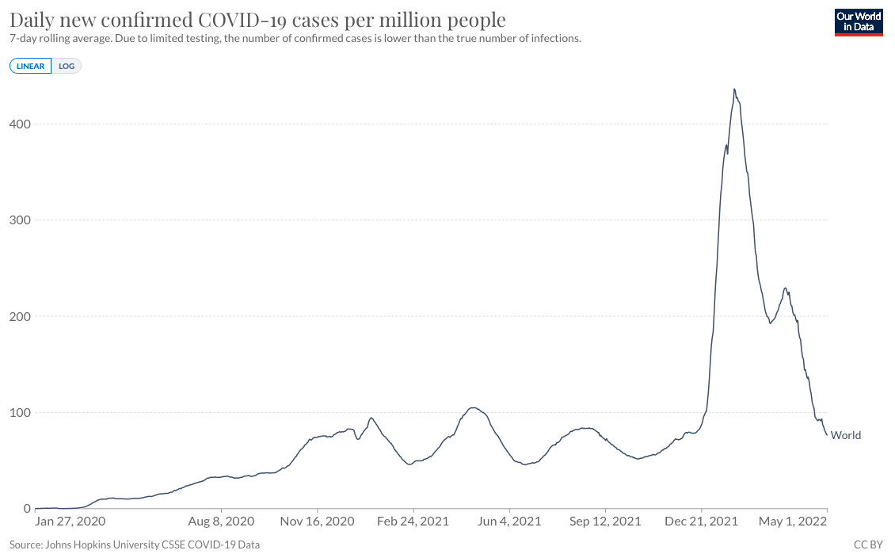
2020: COVID-19
Notes:
More recently, some of you may have heard of or remember the ebola outbreak in 2014 that started in West Africa. Ebola cases had not been reported since the 1970s but in 2014 there was a sudden spike in cases and thousands of deaths. Most of the deaths involved nurses and doctors treating Ebola victims and family members who came into contact with the infected family member. Due to frequent human travel and because it took about three weeks for symptoms to appear, Ebola quickly spread to Europe and the US causing red alert in many countries.
In July of this year an Ebola outbreak in Democratic Republic of Congo is West Africa was declared a public health emergency.

Slide 17
What do REAL-LIFE DISEASE DETECTIVES do?
Notes:
Does anyone know what this career is called?

Slide 18
What do REAL-LIFE DISEASE DETECTIVES do?
LOOK FOR PATTERNS!
What is the problem?
What is the cause?
What we can we do about it?
PUT IT ALL TOGETHER!
Notes:
Does anyone know what this career is called?

Slide 19

What do REAL-LIFE DISEASE DETECTIVES do?
An epidemiologist is a scientist who investigates the factors that cause disease, determine how it is spread, who gets infected and the results of the infection.
Notes:
Epidemiology is the study of diseases as they occur in living things. It focuses on understanding the transmission, spread, and control of diseases. An epidemiologist, is a scientist who investigates the factors that cause disease, determine how it is spread, who gets infected and the results of the infection.

Slide 20

THE SITUATION: 12 SEP 2019
UNKNOWN ILLNESS CAUSES STUDENTS TO FALL ILL AT LOCAL SCHOOL
Local authorities are unsure of the cause of this outbreak, but it appears to be linked to a recent field trip to the Melbourne CBD

Slide 21

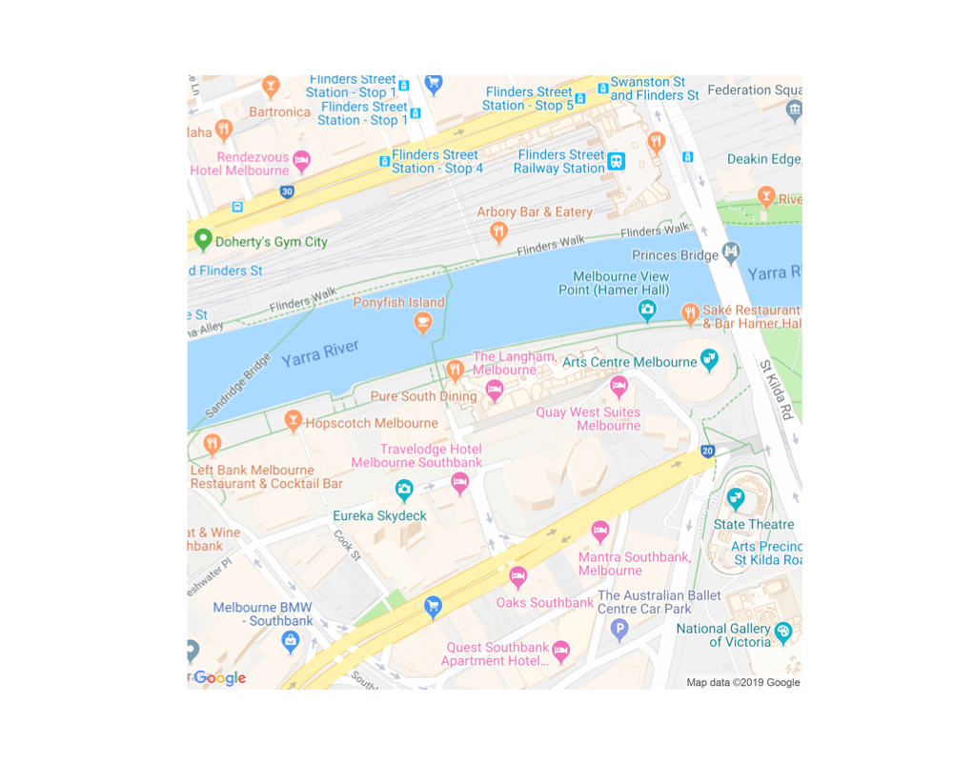
THE FIELD TRIP: 11 SEP 2019
Students from local school attended field trip to the Melbourne CBD to visit the National Gallery of Victoria
8AM: bus to NGV
9-12PM: NGV
12-2PM: lunch
2-4PM: NGV special exhibition
4PM: return bus

Slide 22
DISEASE DETECTIVES: you!
You have been provided the following information:
First name
Class
Age
Sex
Height
Weight
Were they sick?
Reported symptoms
YOUR TOOLKIT:
Notes:
Understand who is infected/at risk
Who is infected? What were they doing?
What caused the outbreak?
Who might be at risk?
Understand the disease
What were the symptoms and effects?
How was it transmitted?
How did it spread?
How was it contained?

Slide 23

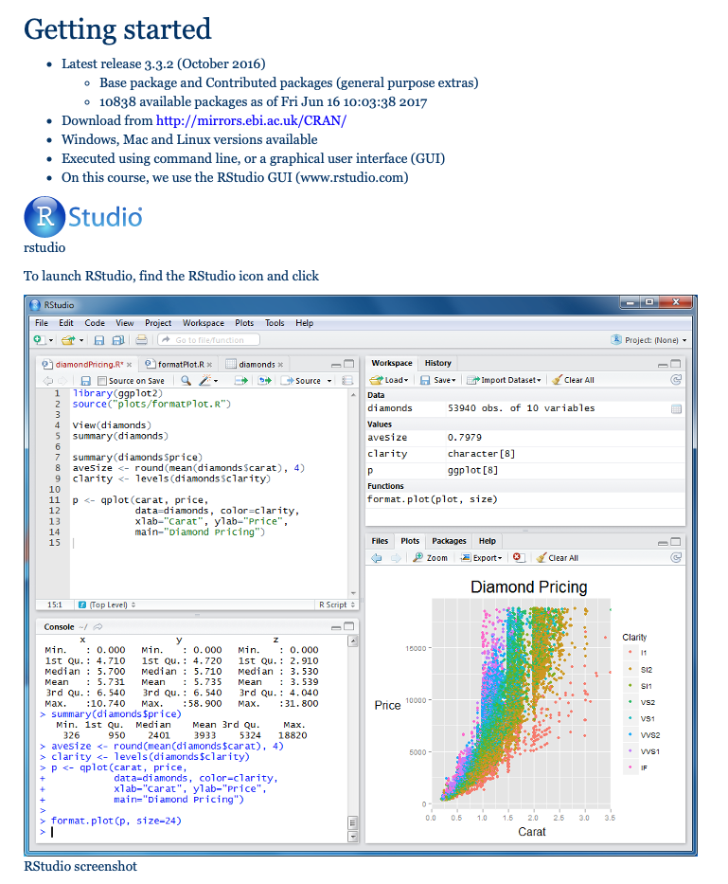
Learn how to code in R

Slide 24

Exercise 1 : Getting familiar with R

Slide 25

Open Rstudio

Slide 26
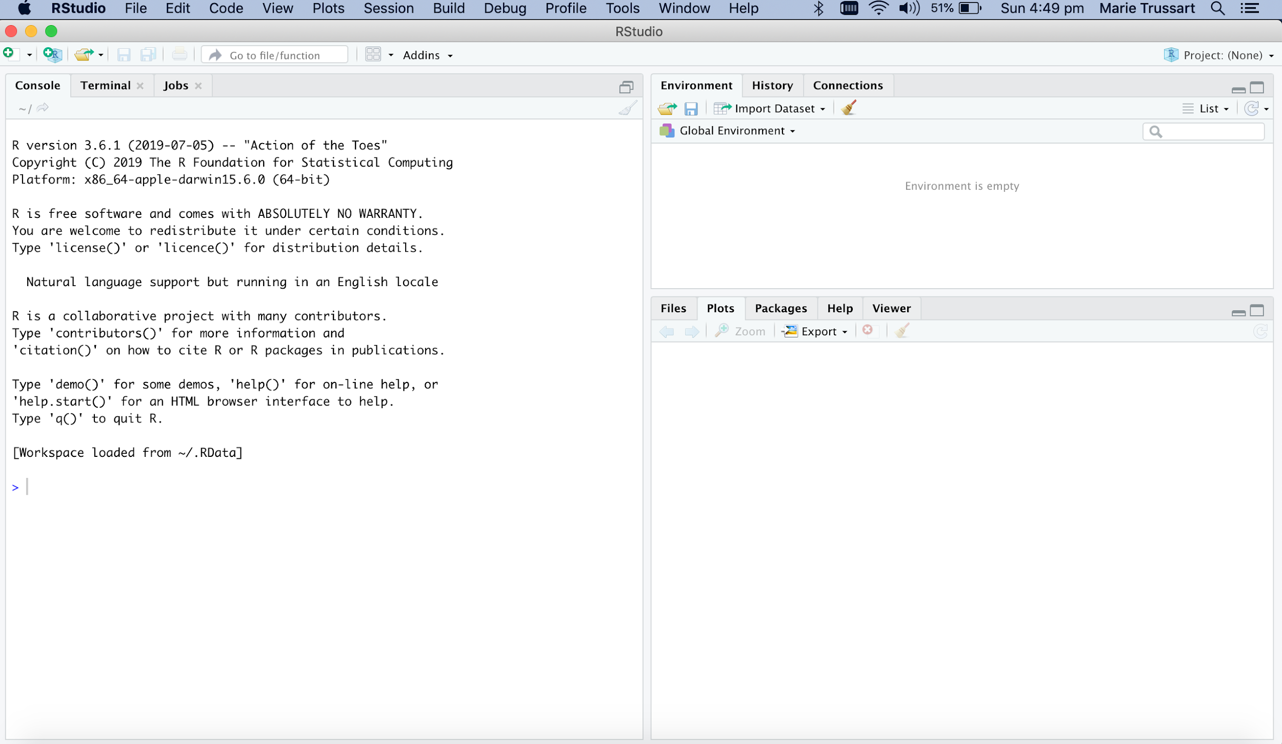
Open Rstudio
Notes:
R version on the top

Slide 27
Open Rstudio
VARIABLES
CONSOLE
PLOTS

Slide 28
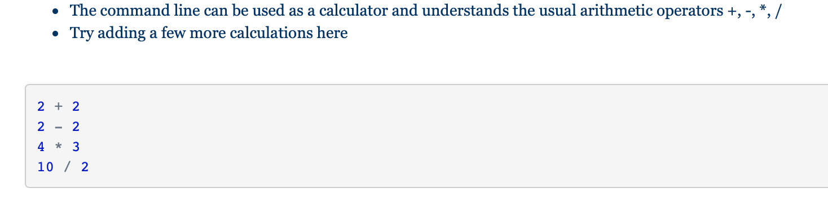
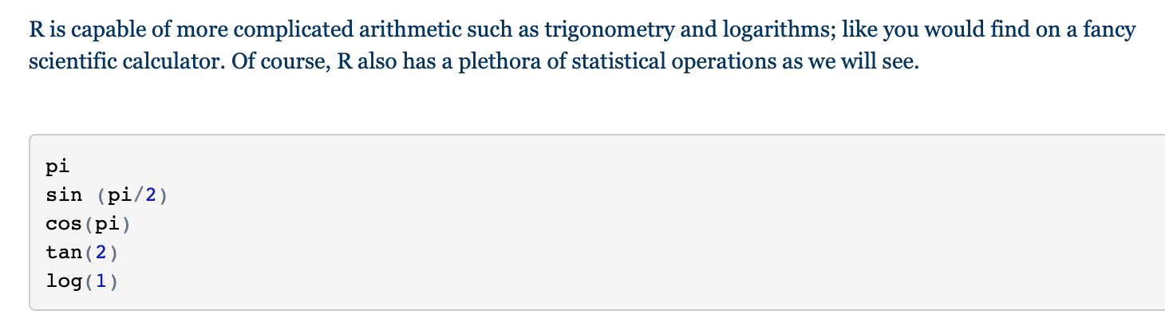
Basic concepts in R: Simple arithmetic
R coding

Slide 29
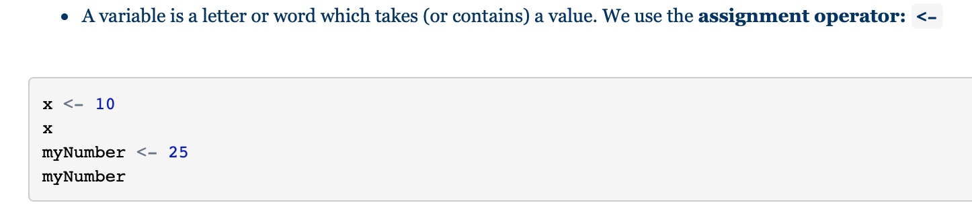
Basic concepts: Variables in R
R coding

Slide 30
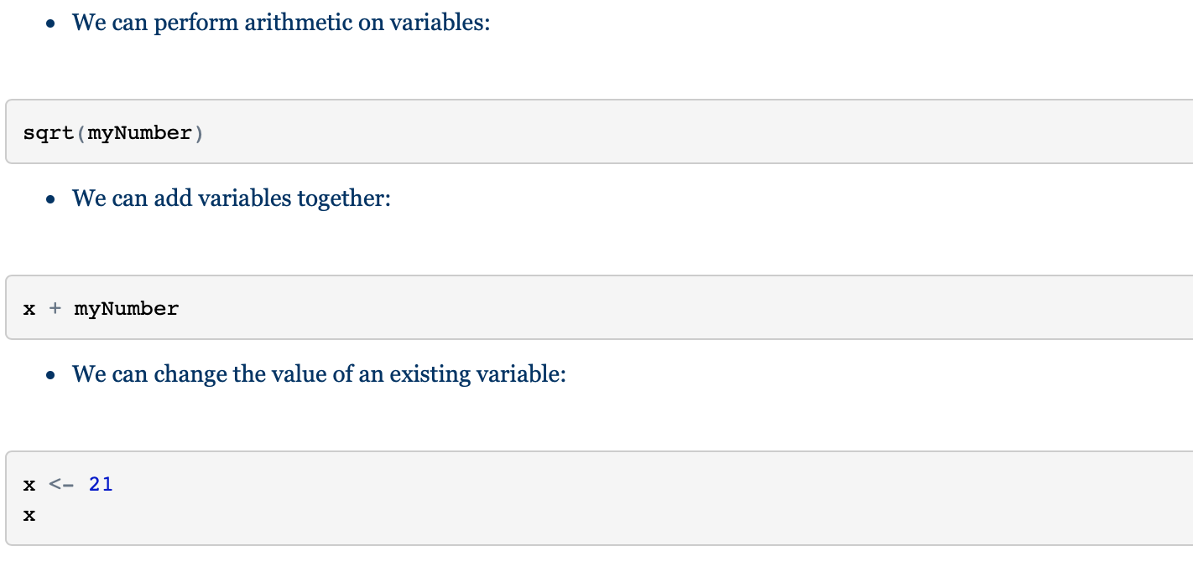
Basic concepts: Variables in R
R coding

Slide 31
Exercise 2: Data exploration with R

Slide 32
Read in the data

Slide 33
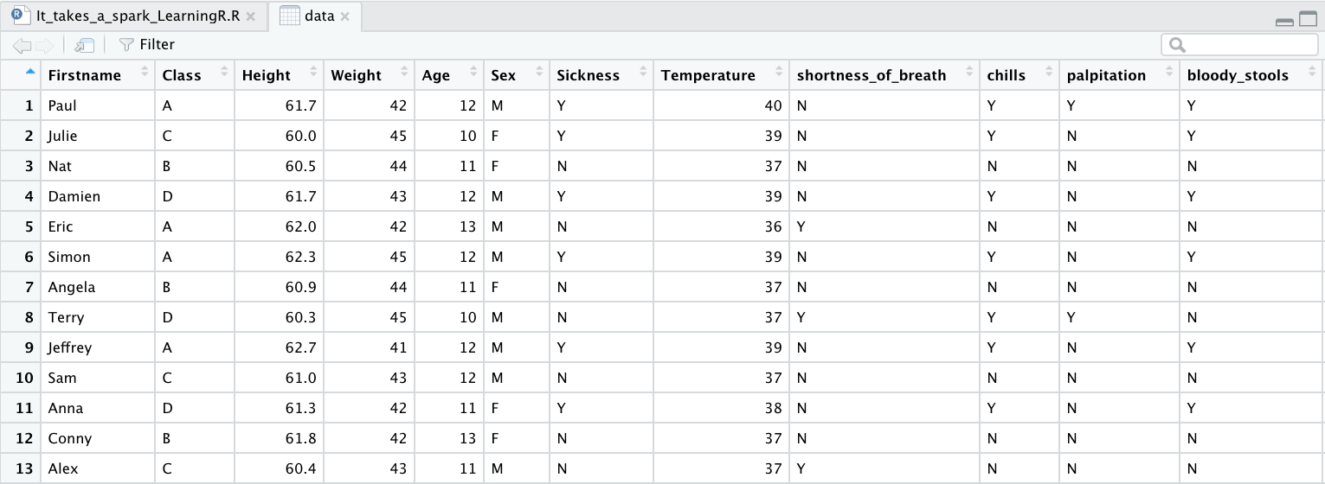
Visualise the data

Slide 34
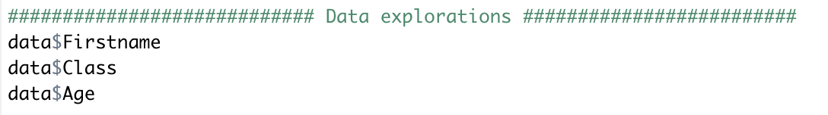
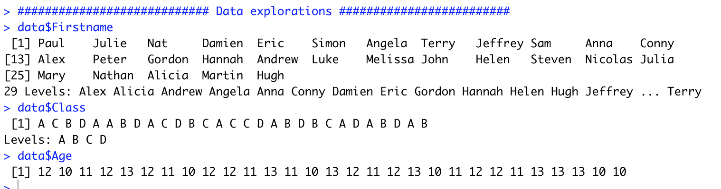
Exploration of the data

Slide 35
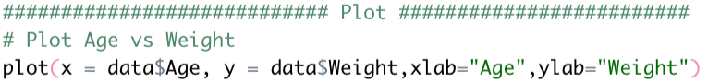
Plot the data using plot command

Slide 36
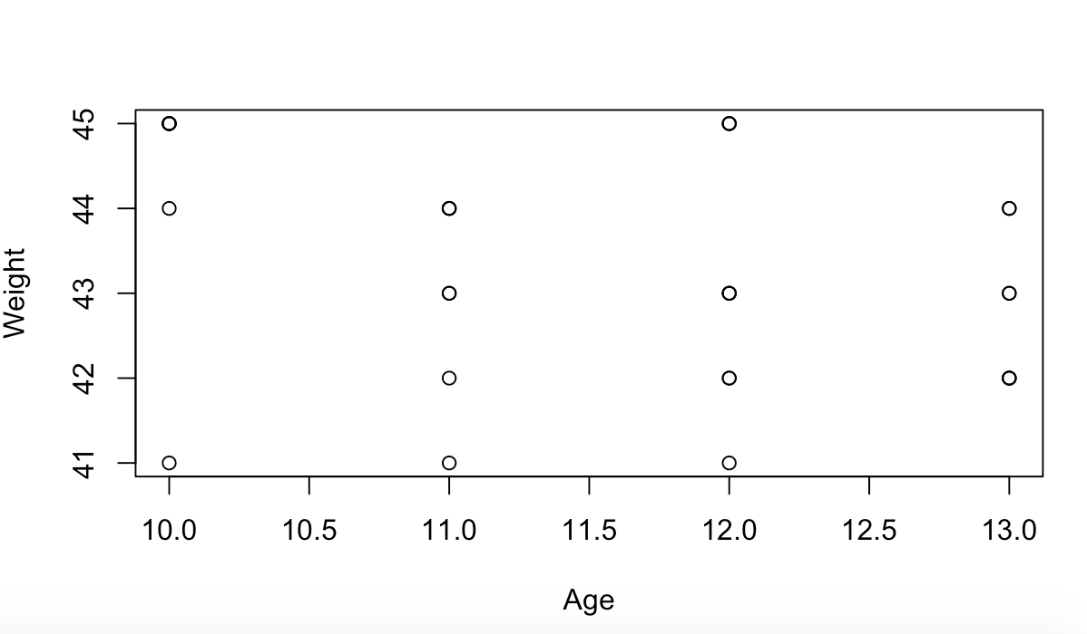
Plot the data using plot command

Slide 37
Plot the data using plot command
Exercise: How do you plot Class vs Age?

Slide 38
Plot the data using plot command
Exercise: How do you plot Class vs Age?

Slide 39
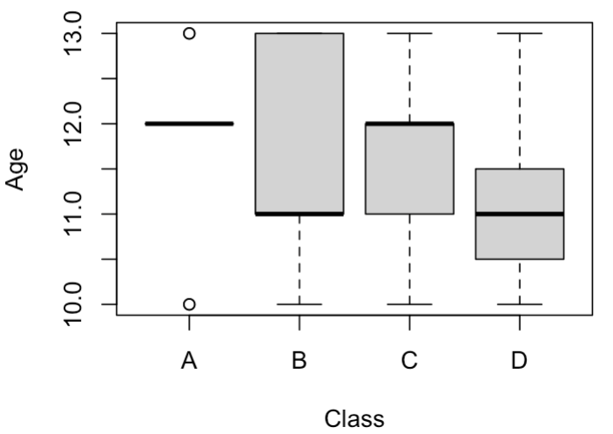
Plot the data using plot command

Slide 40
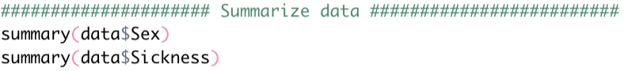
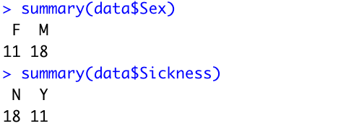
Summarize main epidemiological variables

Slide 41
Summarize main epidemiological variables
Exercise: How do you summarize age?

Slide 42
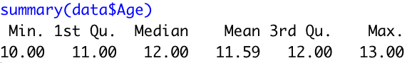
Summarize main epidemiological variables
Exercise: How do you summarize age?

Slide 43
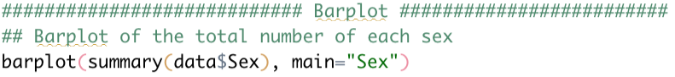
Plot the data using a barplot

Slide 44
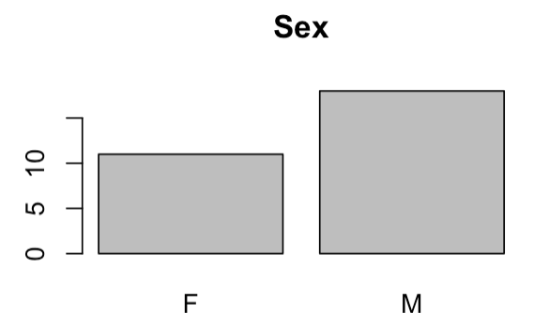
Plot the data using a barplot

Slide 45
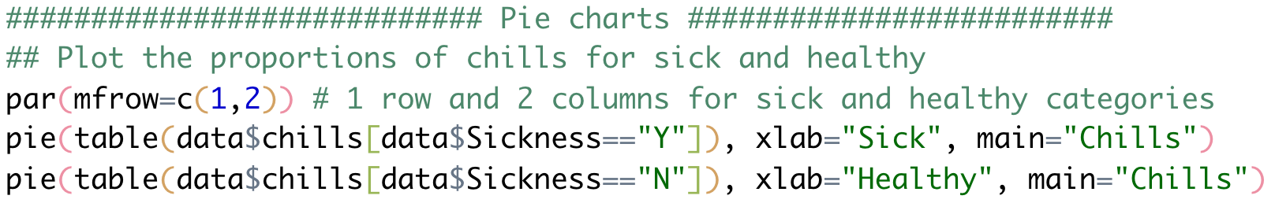
Plot the data using pie charts

Slide 46
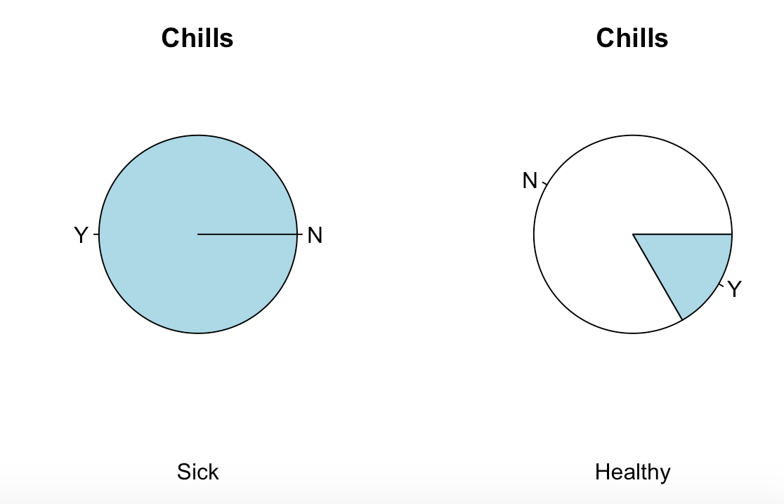
Plot the data using pie charts

Slide 47
TASK # 1
What illness do you think the students have?
(20 mins)
Notes:
Ask the audience… what questions do you think you should ask? What kind of plots do you think you will need to do?
What are the common characteristics of the people that are ill?
What are the common symptoms of infected people?
Understand who is infected/at risk
Who is infected? What were they doing?
What caused the outbreak?
Who might be at risk?
Understand the disease
What were the symptoms and effects?
How was it transmitted?
How did it spread?
How was it contained?

Slide 48
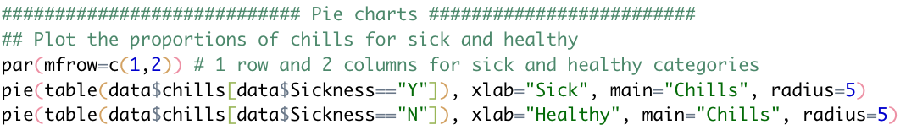
Discover all symptoms using pie plots
Replace the symptoms “chills” with all other symptoms

Slide 49
WHAT ARE THE SYMPTOMS?
Notes:
You have now been provided information on where the students had lunch
Understand who is infected/at risk
Who is infected? What were they doing?
What caused the outbreak?
Who might be at risk?
Understand the disease
What were the symptoms and effects?
How was it transmitted?
How did it spread?
How was it contained?

Slide 50
WHAT ARE THE SYMPTOMS?
Chills
Bloody stools
Abdominal cramps
Nausea
Vomiting
Dizzinness
Fever
Diarrhea
Headache
Pain abdominal
Muscle pains
Notes:
You have now been provided information on where the students had lunch
Understand who is infected/at risk
Who is infected? What were they doing?
What caused the outbreak?
Who might be at risk?
Understand the disease
What were the symptoms and effects?
How was it transmitted?
How did it spread?
How was it contained?

Slide 51
WHAT IS THE DISEASE?
Notes:
You have now been provided information on where the students had lunch
Understand who is infected/at risk
Who is infected? What were they doing?
What caused the outbreak?
Who might be at risk?
Understand the disease
What were the symptoms and effects?
How was it transmitted?
How did it spread?
How was it contained?

Slide 52
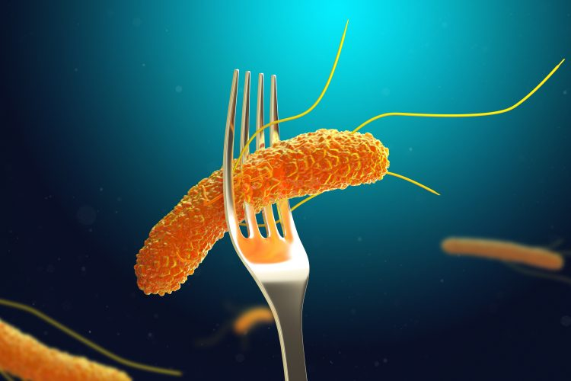
WHAT IS THE DISEASE?
SALMONELLA!
* Note not to scale
Notes:
You have now been provided information on where the students had lunch
Understand who is infected/at risk
Who is infected? What were they doing?
What caused the outbreak?
Who might be at risk?
Understand the disease
What were the symptoms and effects?
How was it transmitted?
How did it spread?
How was it contained?

Slide 53
SALMONELLA 101
An infection with salmonella bacteria commonly caused by contaminated food or water
Food-borne disease
Raw eggs or chickens are the main sources
Notes:
Ask the audience… Now that you know the illness, at what point of the field trip do you think they got it? LUNCH!

Slide 54
TASK # 2
Where did the students get sick during their schooltrip?

Slide 55
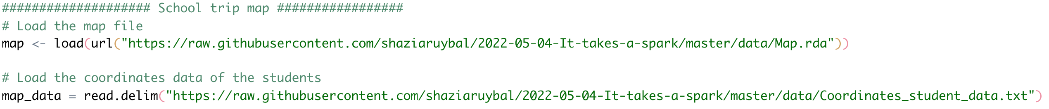
Read in the map data

Slide 56
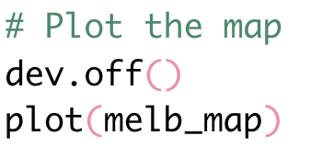
Plot the map

Slide 57
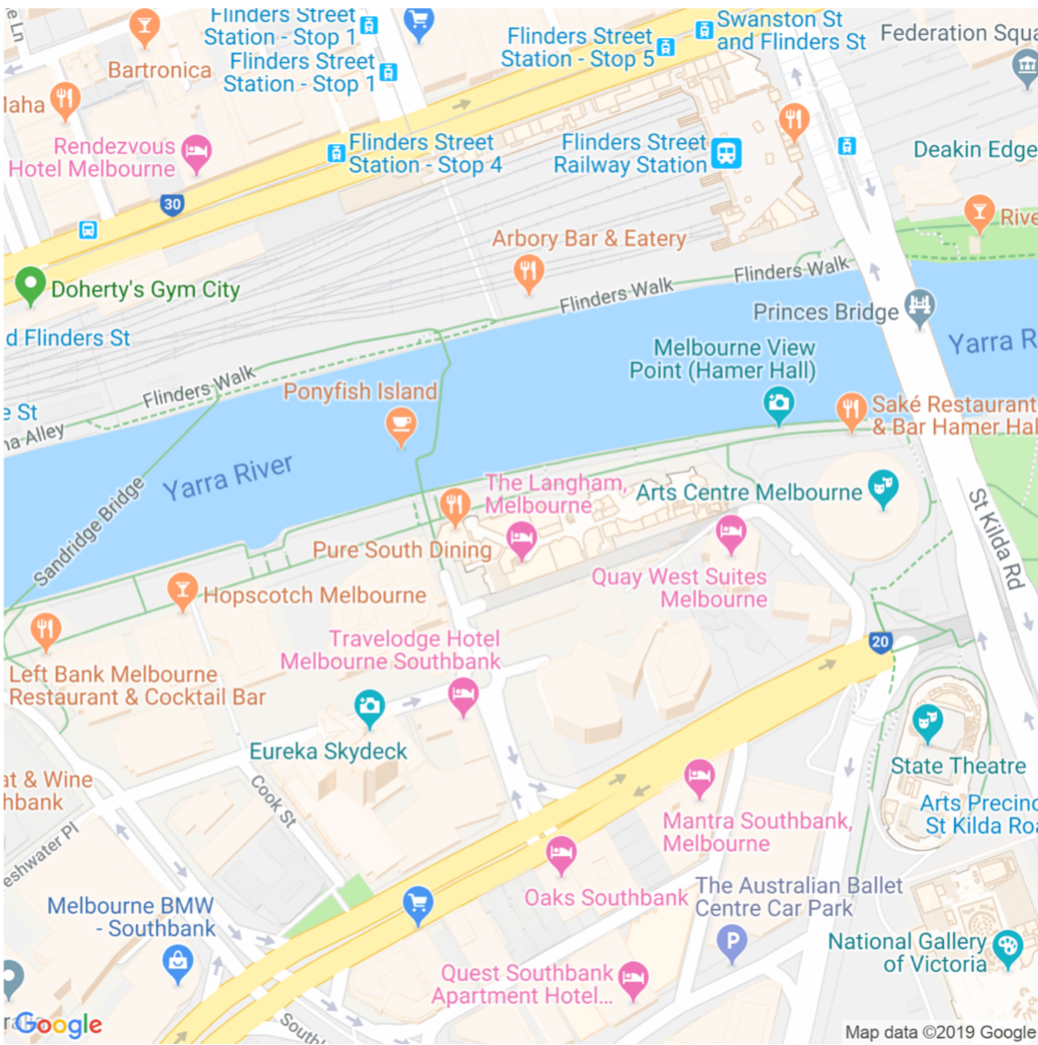
Plot the map

Slide 58
WHAT IS THE CAUSE OF THE DISEASE ?
Let’s plot the location where each student had lunch and color by whether they were sick or not…
Notes:
Check R library
You have now been provided information on where the students had lunch
Understand who is infected/at risk
Who is infected? What were they doing?
What caused the outbreak?
Who might be at risk?
Understand the disease
What were the symptoms and effects?
How was it transmitted?
How did it spread?
How was it contained?

Slide 59
Plot the map + students

Slide 60
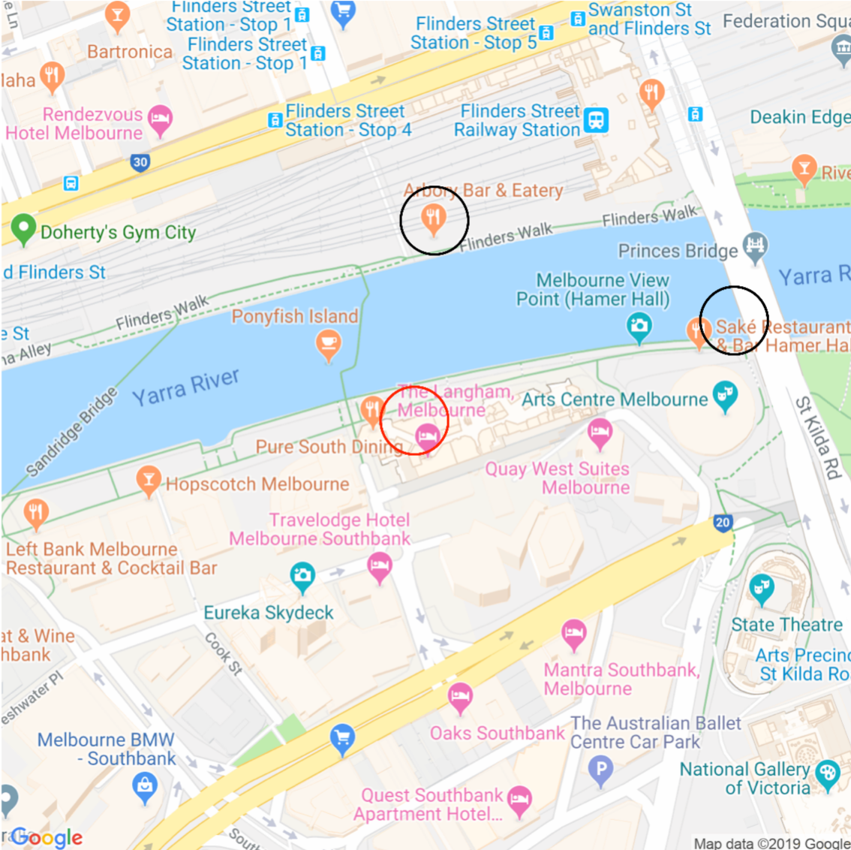
Plot the map + students

Slide 61
WHAT IS THE CAUSE OF THE DISEASE ?
Notes:
Check R library
You have now been provided information on where the students had lunch
Understand who is infected/at risk
Who is infected? What were they doing?
What caused the outbreak?
Who might be at risk?
Understand the disease
What were the symptoms and effects?
How was it transmitted?
How did it spread?
How was it contained?

Slide 62
THE SITUATION: 12 SEP 2019
This activity is based on a real-life outbreak!
https://www.facebook.com/7NEWSMelbourne/videos/10153514114084301/

Slide 63
WHAT WOULD BE YOUR NEXT STEPS?
Notes:
Langham Hotel? -- food security training, food handling/preparation, inform restaurant customers
**** Contact anyone else who ate there on 11 September
Inform and educate on salmonella symptoms and risks of eating raw meat/chicken/eggs

Slide 64
WHAT WOULD BE YOUR NEXT STEPS?
Making a complaint about a food business in Victoria:
https://www2.health.vic.gov.au/public-health/food-safety/food-safety-information-for-consumers/complaints
Reporting a food safety issue within City of Melbourne https://www.melbourne.vic.gov.au/community/health-support-services/health-services/Pages/food-safety.aspx
Department of Health Reporting system:
https://www1.health.gov.au/internet/main/publishing.nsf/Content/cdnareport.htm
Notes:
Langham Hotel? -- food security training, food handling/preparation, inform restaurant customers
**** Contact anyone else who ate there on 11 September
Inform and educate on salmonella symptoms and risks of eating raw meat/chicken/eggs

Slide 65
TODAY’S WORKSHOP:
Learn what are outbreaks and who are disease detectives
Learn how to code using R
Learn R skills to become a disease detective!

Slide 66
MORE RESOURCES
https://education.rstudio.com/learn/beginner/
RStudio Education for beginners
R for Data Science
https://r4ds.had.co.nz/
https://epirhandbook.com/en/
The Epidemiologist R Handbook
RYou With Me (R Ladies Sydney)
https://rladiessydney.org/courses/ryouwithme/
and so many others…

Slide 67





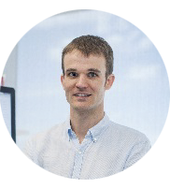


A big thanks to our amazing and faithful sponsors
Matt Ritchie

